Slide 1
Plano Photography Club Pre-Meeting Training Class Beginning in May 2017

Slide 2
Pre-Meeting Training Classes Starting May 2017
Group | Instructor | Limited Attendnnce | Maximum Participants | Location | Dates
Open Topics | Marea Downey/ Ron Marabito | No | N/A | Room 3 | Start May
Color and Light | Ernie Tacsik | No | N/A | Room 4 | May - August
Fundamentals (Two Classes/Month) | Bud Mallar | Yes | 6 | Room 8 | May - August
Lightroom | Dennis Fritsche | No Must buy book | N/A | Room 7 | May -Nov
Assignments | Larry Petterborg | No | N/A | Room 5 | May - Nov
Lighting | John Lehman | Yes | 6 | Room 1 | May - August

Slide 3
Open Topics – Marea Downey & Ron Marabito
May 2017 – Ron Marabito
Digital mats and frames. Ron will demonstrate how I approach this technique in Photoshop. The goal is to compliment the image; as is true of any real mat and frame combination.
June 2017 – Marea Downey
Getting it right in the camera, is the last piece of the process of creating a worthwhile image. I will hope to convey to attendees that the work which goes into the research of the subject, preparation, camera capabilities, and the photographer’s skills in using the camera, all culminate in creating the image the photographer wants to share with the viewer. I would like to touch again on composition and getting the exposure right, so in post-processing, the photographer is not throwing away pixels thereby deteriorating the quality of the piece. In short, I will share what how one’s inspiration, drive and tenacity can finally produce an image to be pleased with.
July 2017 – Marea Downey
Publishing a Book. I would like to share with members what I have learned in dealing with publishers about what is required for images for publication. It is important to consider all aspects of the finished story while photographing, and having been involved in the production of a book for the BBC TV series, and also books I have created on assignment by two companies, I would like to share some perspectives I have learned.

Slide 4
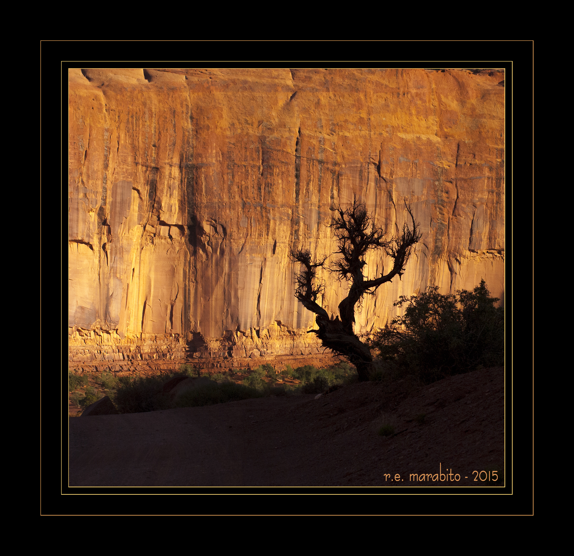

Slide 5
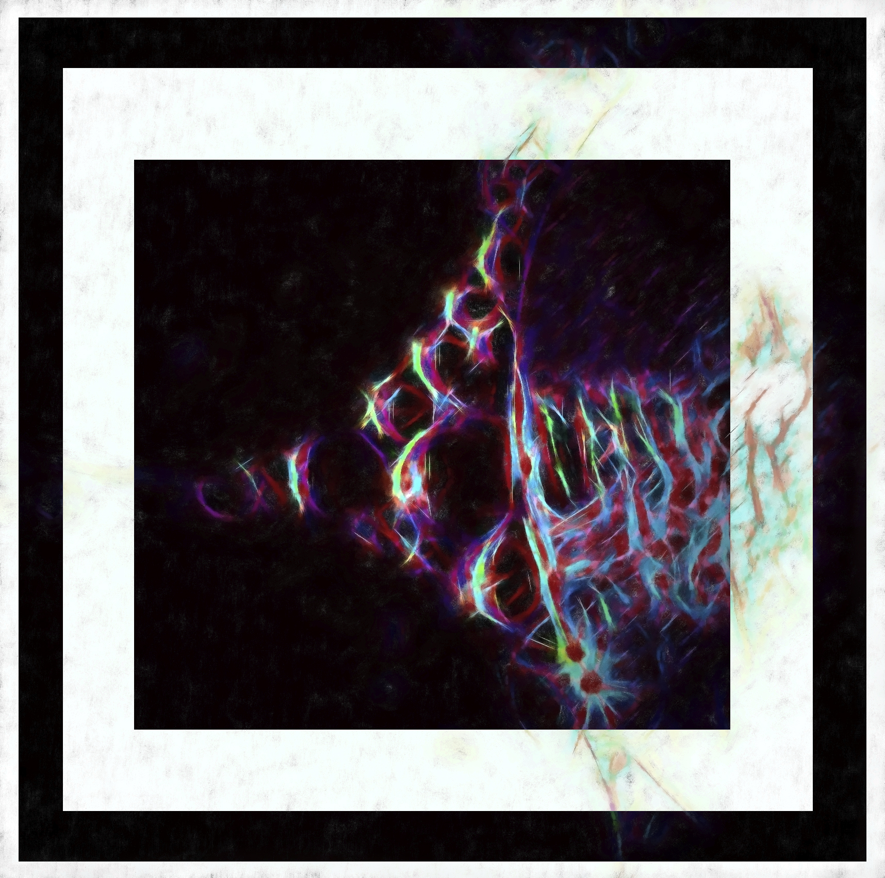

Slide 6
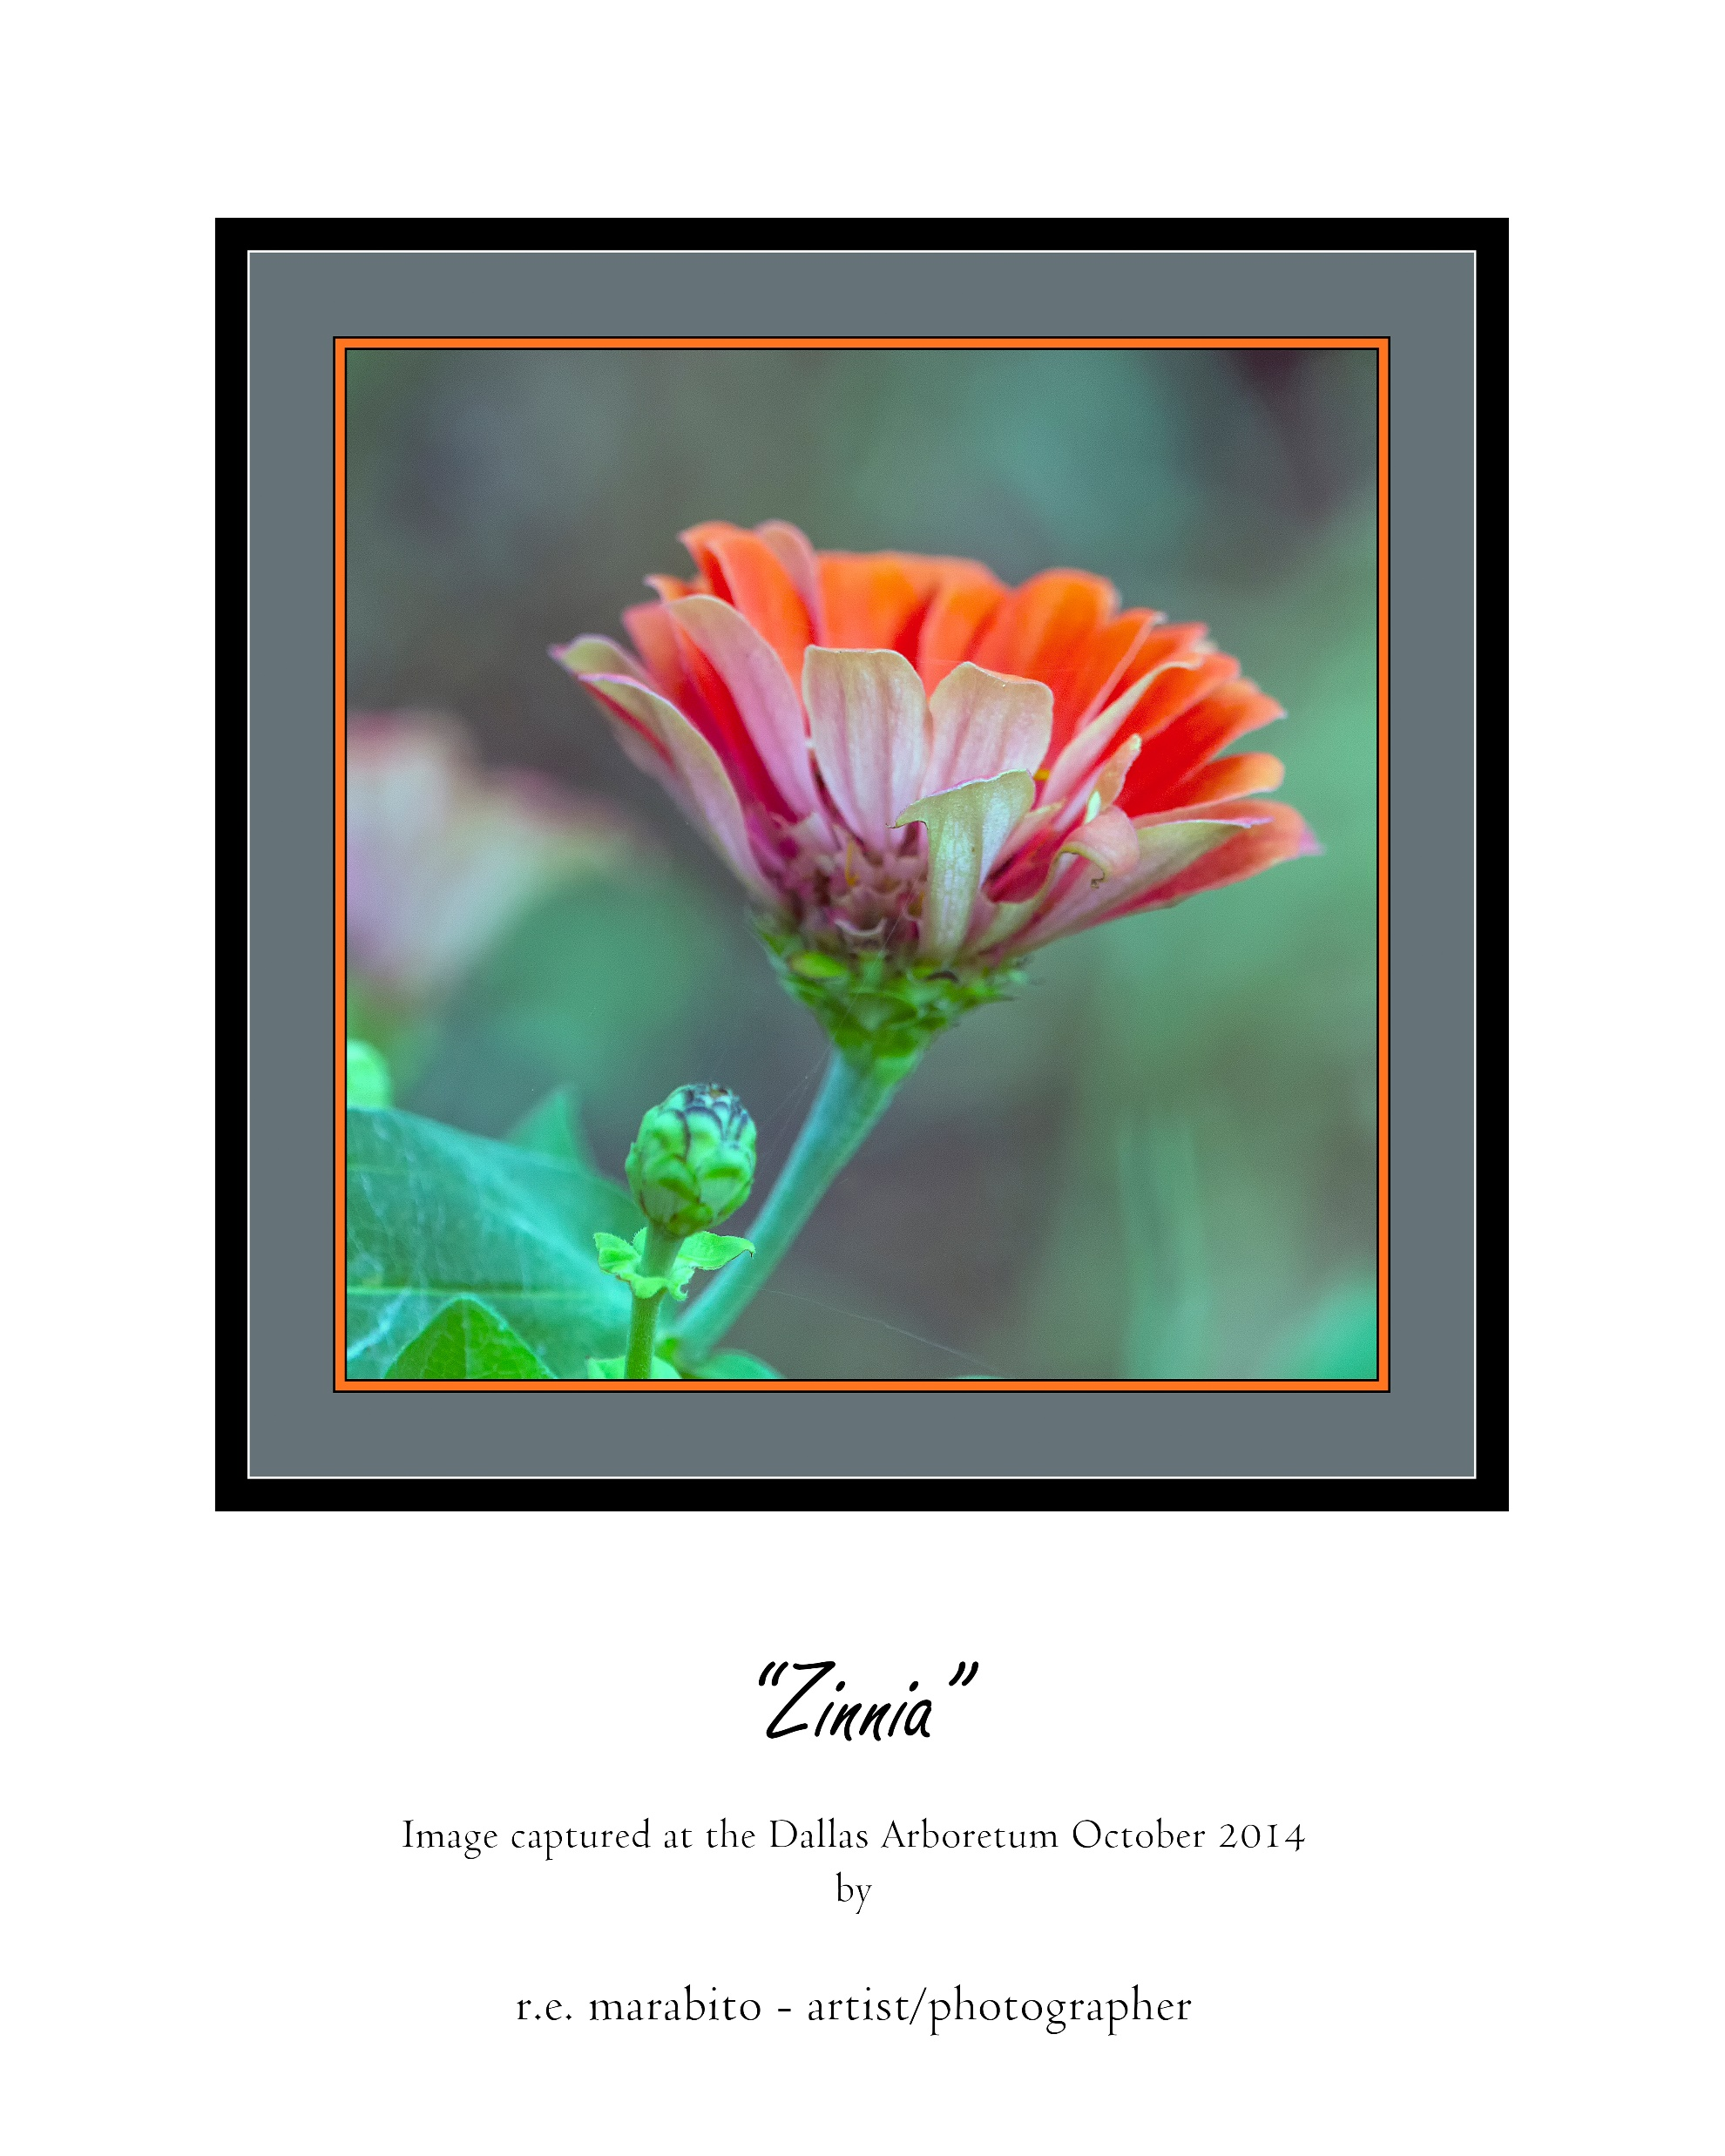

Slide 7
Assignments Study Group – Larry Petterborg
The purpose of this group is to help members make better images through actively working on, completing, and sharing assignments.
Anyone signing up for this group willingly accepts the challenge to participate in each assignment by making new images every week.
In addition, each participant will agree to work collaboratively to foster learning among the members of the group by offering constructive criticism of submitted images.
ASSIGNMENTS forming the basis of this activity:
Portrait of a stranger.
Same subject, photographed three (3) different ways/times.
Action (e.g. sports, animals, moving things).
Geometric patterns (Sept. PPC contest).
Idea for PPC October print contest.
Each participant must agree to:
Complete each assignment, post images to the group site on Flickr, and comment on the images posted by other members of the group.
Provide camera settings, processing information, and reasons/thought process for creating the image posted.
Comment on images posted by other members of the group by stating clearly what you like about the picture and what/how you think it might be improved.
Send the leader at least one RAW file from each assignment for in class discussions.
Optional: revise and resubmit images following groups discussions.

Slide 8
Lighting – John Lehman
“Create Your Own Light” Basic Artificial Light Photography
If you want to develop more proficiency in speedlight work, this will get you started.
Session 1: Basics of speedlight orientation: How to mate it with your camera, what are the buttons on the flash and how does the camera control the flash. The goal is to get the flash mated up with your camera and understanding where the controls are found.
Session 2: Understanding TTL (more automatic use of flash) discussing ways to gain good exposure control, how to understand the interaction of shutter speed, aperture and ISO. Goal to practice during that month and submit some samples
Session 3: Understanding off camera flash and use of manual control of the flash and your camera, including power levels, zooming the flash, light modifiers (some inexpensive to try out) and ways to trigger off camera flash (low cost)
Session 4: Continuous LED lighting. Options to using LED as an alternative to speedlights. These are often very inexpensive and useful. We will discuss pros and cons of LED, practice with still life/table top use.
Class will be limited to 6 people so there is enough time to help each person gain the understanding of their individual camera. What to bring: bring your camera, your speedlight and the manuals for each.

Slide 9
Color and Light – Ernie Tacsik
This class is a broad investigation of color and light as applicable to photography. How do we see color? How does a camera see color? How does light impact color? With an objective to improve the students’ photography and photo editing skills, this class is a broad investigation of topics including: color models/temperature/spectrums/representations, light sources, metering, white balance, white/gray cards, histograms, and monitor calibration. While the material may be somewhat technical at times, this course will benefit students of all skill levels.
Note this is NOT a course on photographic lighting.

Slide 10
Photography Fundamentals Study Group – Bud Mallar
The purpose of this Study Group is to provide basic understanding of photography to enhance the participants' ability to capture technically 'better' images, be more creative, to determine what ‘equipment’ they need, and to use various software platforms to display and/or enhance their photographs.
This group, limited to the first 6 participants signing up, will meet every two weeks for a total six times (dates and times below) at the West Plano Presbyterian Church beginning May 18th. Participation in all six sessions is essential as 'make up' opportunities are limited.
The group will participate in lectures, discussions and sharing images in the following areas:
1. Things the participants can do on their own to become better photographers. One hour beginning at 6:00 pm on 05/18.
2. Use of shutter speed and f/stop for better exposures, enhanced creativity and dealing with difficult lighting situations. Two hours beginning at 7:00 pm on 06/01.
3. What are all those settings and buttons are on your camera, what they do, and how to use them. One hour beginning at 6:00 pm on 06/15.
4. The equipment (lenses, filters, spares, personal items, etc.) which should be in a 'camera bag' - why and how to use them. Two hours beginning at 7:00 pm on 07/06.
5. Rules and ideas on composition. One hour beginning at 6:00 pm on 07/20.
6. A hands on orientation to Lightroom to enable simple editing by the participants. Two hours beginning at 7:00 pm on 08/03
.For this Study Group, please sign up with or direct any questions to Bud Mallar: bmallar@sbcglobal.net

Slide 11
Lightroom – Dennis Fritsche
The purpose of this class is to provide participants with the knowledge and skills to enhance their photographs using the Adobe Lightroom Develop Module.
The class will follow Michael Frye’s excellent e-book Landscapes in Lightroom: The Essential Step-by-Step Guide. Between each class are asked to complete assigned reading and then we will discuss and practice during the class. Do not plan on bringing a notebook computer. This class will not cover the library module.
To participate, you will need to purchase the e-book.
http://www.michaelfrye.com/landscapes-in-lightroom/
Session 1 & 2 – Develop Module controls and workflow
Sessions 3 – 6 Examples 1-4 one each session.
Sessions 7 – 8 Examples 5-8 two each session.

